Slide 1
I2C with HoneyWell Humidicon
Brandon Martinez and Nick Mitchell

Slide 2
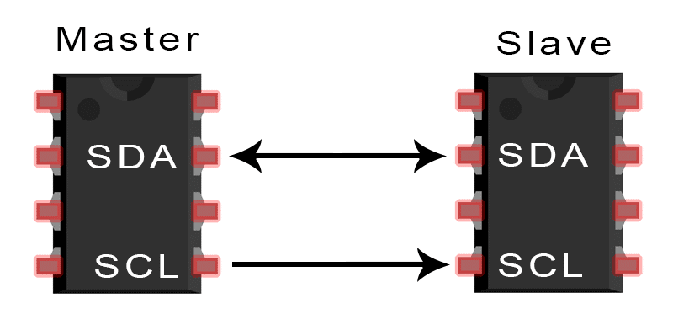
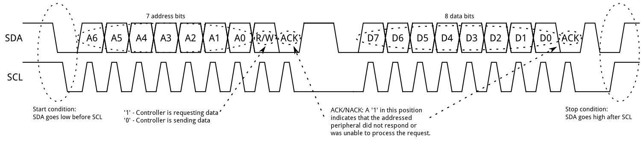
How I2C works
Includes a master and a slave
Two data lines:
SDA - sends/receives data
Clock - data recorded on falling edges

Slide 3
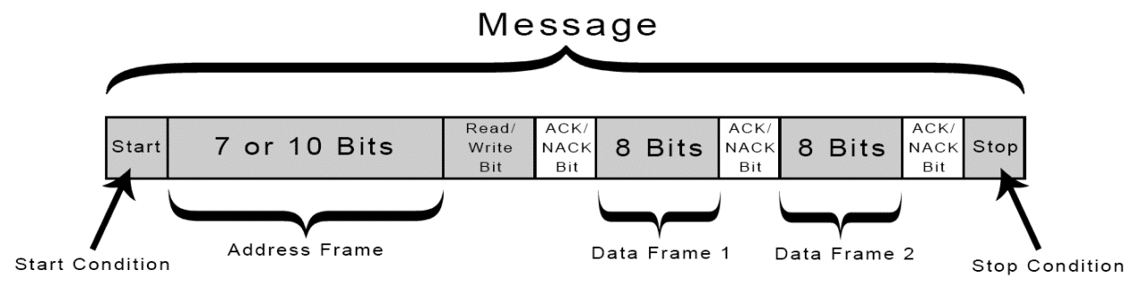

Slide 4
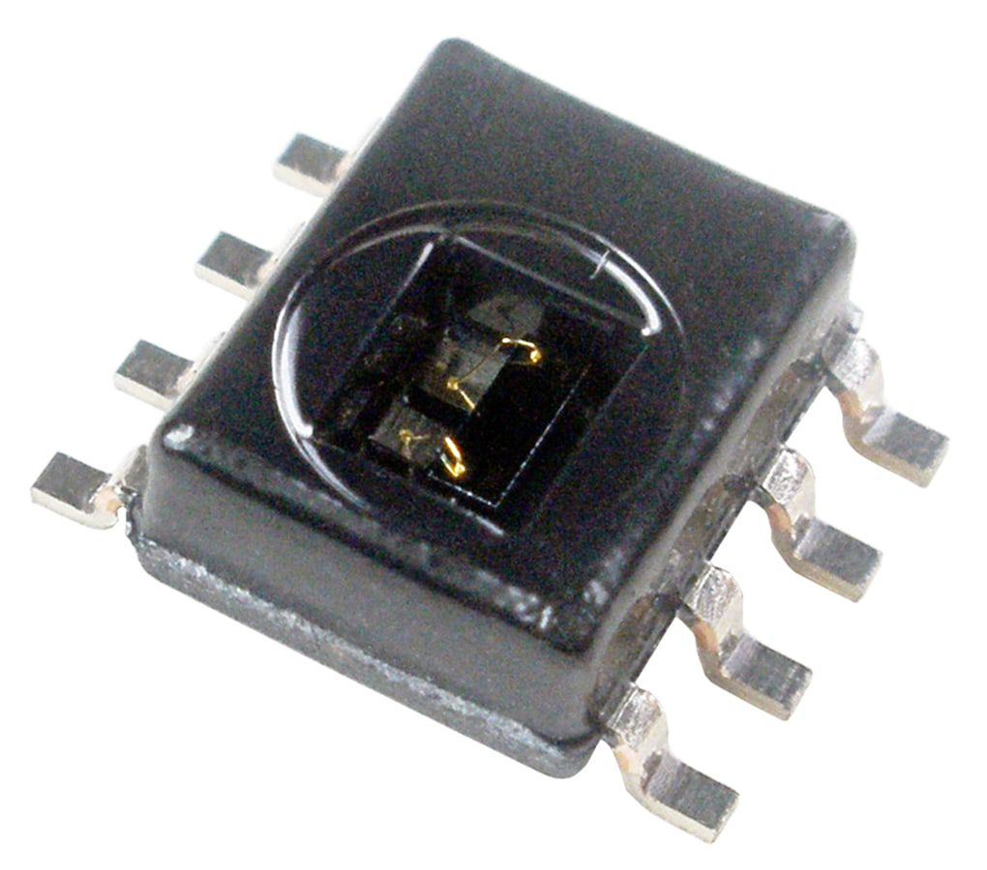
Honeywell Humidicon
Humidity and temperature sensor
14 bit
Slave address: 0x27

Slide 5
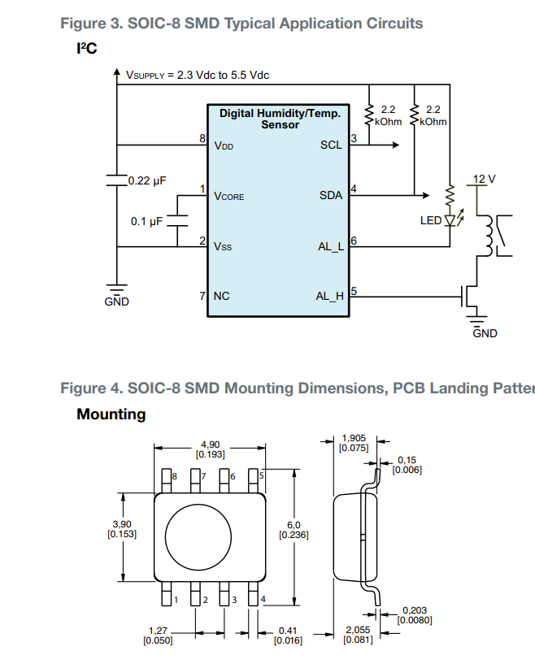
Connections
Vdd connected to 3.3V on ESP32
GND connected to GND
SCL to GPIO19 w/ pullup resistor
SDA to GPIO18 w/ pullup resistor
Recommended 0.22 uF cap between
Vdd and GND, 0.1 uF between Vcore and
GND

Slide 6
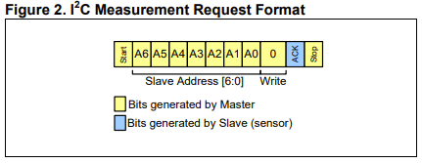
How to use
First send a Measurement Request, then send a data fetch

Slide 7
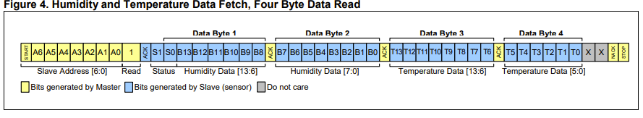

Slide 8
References
Honeywell I2C Comms
Honeywell Sensor Datasheet

